Slide 1
Influence of morally-framed messaging and source credibility on environmental attitudes
A Research Proposal in Progress
Learning Cognition & Instruction Research Lab

Slide 2
Message
Person
Attitudes
Notes:
How do the qualities of a message influence a person to change their attitudes

Slide 3
What are attitudes?

Slide 4
Attitudes
Favorable or unfavorable evaluation of a target (Albarracin & Shavitt, 2018)
A target can be a object, event, or situation.
Message

Slide 5
Attitudes
Favorable or unfavorable evaluation of a target (Albarracin & Shavitt, 2018)
Person
Developmental Stage
Emotions
Language
Values
Goals
Notes:
The current study mainly takes into account the language and the values of a person.

Slide 6
Attitudes
Favorable or unfavorable evaluation of a target (Albarracin & Shavitt, 2018)
Person
Developmental Stage
Emotions
Language
Values
Goals
Notes:
The current study mainly takes into account the language and the values of a person.

Slide 7
Attitudes
Favorable or unfavorable evaluation of a target (Albarracin & Shavitt, 2018)
Person
Social Relationships
Communicator
Media
Culture
Language
Values
Notes:
We must also consider how the social relationships that a person is a part of influences their evaluation toward targets.
We must consider who or what is relaying the message of influence
The medium in which the message is transmitted thru
And how culture influences a person’s evaluation

Slide 8
Attitudes
Favorable or unfavorable evaluation of a target (Albarracin & Shavitt, 2018)
Person
Social Relationships
Communicator
Media
Culture
Language
Values
Notes:
We must also consider how the social relationships that a person is a part of influences their evaluation toward targets.
We must consider who or what is relaying the message of influence
The medium in which the message is transmitted thru
And how culture influences a person’s evaluation

Slide 9
Attitudes
Favorable or unfavorable evaluation of a target (Albarracin & Shavitt, 2018)
Person
Sociohistorical
Economic
Political
Language
Values
Social
Relationships
Communicator
Media
Notes:
Lastly, we must especially consider the sociohistorical conxtext in which the person lives.
That is, we must take into account the economic and political factors that influence evaluation

Slide 10
Attitudes
Favorable or unfavorable evaluation of a target (Albarracin & Shavitt, 2018)
Person
Sociohistorical
Economic
Political
Language
Values
Social
Relationships
Communicator
Media
Notes:
Lastly, we must especially consider the sociohistorical conxtext in which the person lives.
That is, we must take into account the economic and political factors that influence evaluation

Slide 11
Two Theoretical Frameworks
Moral Foundations Theory
Moral Foundations Theory
Elaboration Likelihood Model
Notes:
Attitudes have a moral basis (Brandt & Wetherell, 2012)
Moral Foundations Theory (Haidt & Graham, 2007; Graham, Haidt, & Nosek, 2009)

Slide 12
Moral Foundations Theory
Harm
Protect most vulnerable
Fairness
V
Reciprocal Altruism
Moral System
P
I
Ingroup
Tendency for tribalism
B
T
Authority
Hierarchical social interactions
PM
Purity
Sense of disgust
Graham, Haidt, & Nosek (2009)
Notes:
MFT states that we all have an innate moral system from which we base our attitude formation
What is a moral system?

Slide 13
Moral Foundations Theory
Harm
Individualizing Foundations
Fairness
Moral System
Liberalism
Ingroup
Binding Foundations
Authority
Conservatism
Purity
Graham, Haidt, & Nosek (2009)
Notes:
Research done using MFT as a basis has shown a clear delineation in the reliance on moral foundation as a function of political ideology.

Slide 14
Research Underlying Moral Foundations
Feinberg & Willer (2012)
Moral roots of environmental attitudes
Clifford & Jerit (2013)
Moral foundations’ influence on debate of stem cell research
Feinberg & Willer (2015)
Influence of moral foundations on political rhetoric
Wolsko, Ariceaga, & Seiden (2016)
Notes:
Research has been conducted using MFT as a basis to influence attitude change

Slide 15
Wolsko, Ariceaga, & Seiden (2016)
Morally-framed message influences environmental attitudes and intentions to engage in conservation behaviors, as a function of political ideology.
Individualizing
Binding
Text
Picture
Text
Picture
Text
Picture

Slide 16
Individualizing Text
Individualizing Graphic
Show your love for all of humanity and the world in which we live by helping to care for our vulnerable natural environment by taking action. By caring for the natural world, you are helping to ensure that everyone around the world gets to enjoy fair access to a sustainable environment. Do the right thing by preventing the suffering of all life-forms and making sure that no one is denied their right to a healthy planet. SHOW YOUR COMPASSION.
Notes:
Ended with a strong IND tag line

Slide 17
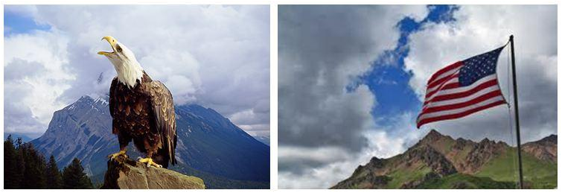
Binding Text
Binding Graphic
Show you love your country by joining the fight to protect the purity of America's natural environment. Take pride in the American tradition of performing one's civic duty by taking responsibility for yourself and the land you call home. By taking a tougher stance on protecting the natural environment, you will be honoring all of Creation. Demonstrate your respect by following the examples of your religious and political leaders who defend America's natural environment. SHOW YOUR PATRIOTISM!
Notes:
Ended with a strong BND tag line

Slide 18
Wolsko, Ariceaga, & Seiden (2016)
Results:
Individualizing Condition
V
Liberals
Conservatives
Binding Condition
Liberals
Conservatives
V

Slide 19
Two Theoretical Frameworks
Elaboration Likelihood Model
Moral Foundations Theory
Elaboration Likelihood Model

Slide 20
Elaboration Likelihood Model
The more a person thinks about a message, the more likely the person will be persuaded by the message (Petty & Cacioppo, 1986)
Central Route
High = High Elaboration
More
Persuasion
Message
Cognitive Processing
Low = Low Elaboration
Less
Peripheral Route
Notes:
Persuasion depends on amount of elaboration (Petty & Cacioppo, 1986)

Slide 21
Central Route
High = High Elaboration
More
More Likely
Persuasion
Attitude Change
Cognitive Processing
Low = Low Elaboration
Less
Less Likely
Peripheral Route

Slide 22
Two Theoretical Frameworks
Moral Foundations Theory
Elaboration Likelihood
Model
Source Credibility
Notes:
Attitudes have a moral basis (Brandt & Wetherell, 2012)
Moral Foundations Theory (Haidt & Graham, 2007; Graham, Haidt, & Nosek, 2009)

Slide 23
Source Credibility
Qualities that influences attitudes (Ohanian, 1990)
Presumed
General assumptions
Source
Credibility
Reputed
Labels
Surface
First glance
Experienced
First-hand experience

Slide 24
Source Credibility
Logo
Contributes to credibility (Lowry, Wilson, & Haig, 2014)
Influences attitudes towards source (Childers & Jass, 2002)
Notes:
Source Credibility influences perception of message (Clark & Evans, 2014; Tormala, Brinol, & Petty, 2005)

Slide 25
Purpose
Perceived
Source
Credibility
Moral
Frame
Environmental
Attitudes

Slide 26
Materials and Procedure
EXPERIMENTAL
INTERVENTION
PRE-EXPERIMENT
POST-EXPERIMENT
Environmental Attitudes
Persuasive Message
Demographics
Environmental
Attitudes
Source Credibility
Age
Explicit
or
EAI
α = .62-90
Political Ideology
Major
SDO
α = .89
Implicit
Etc.
IAT
α = ∼ .75
IND
BND
IND
BND
News Consumption Habits
Notes:
Include reliability and validity for measures

Slide 27
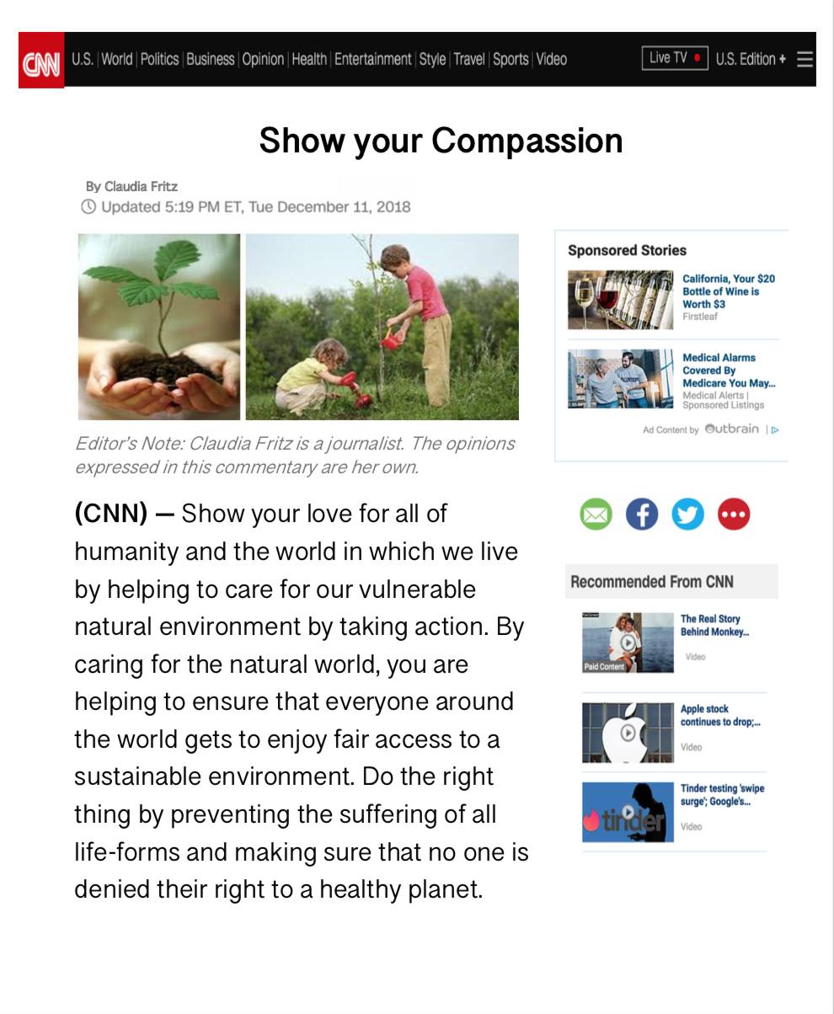
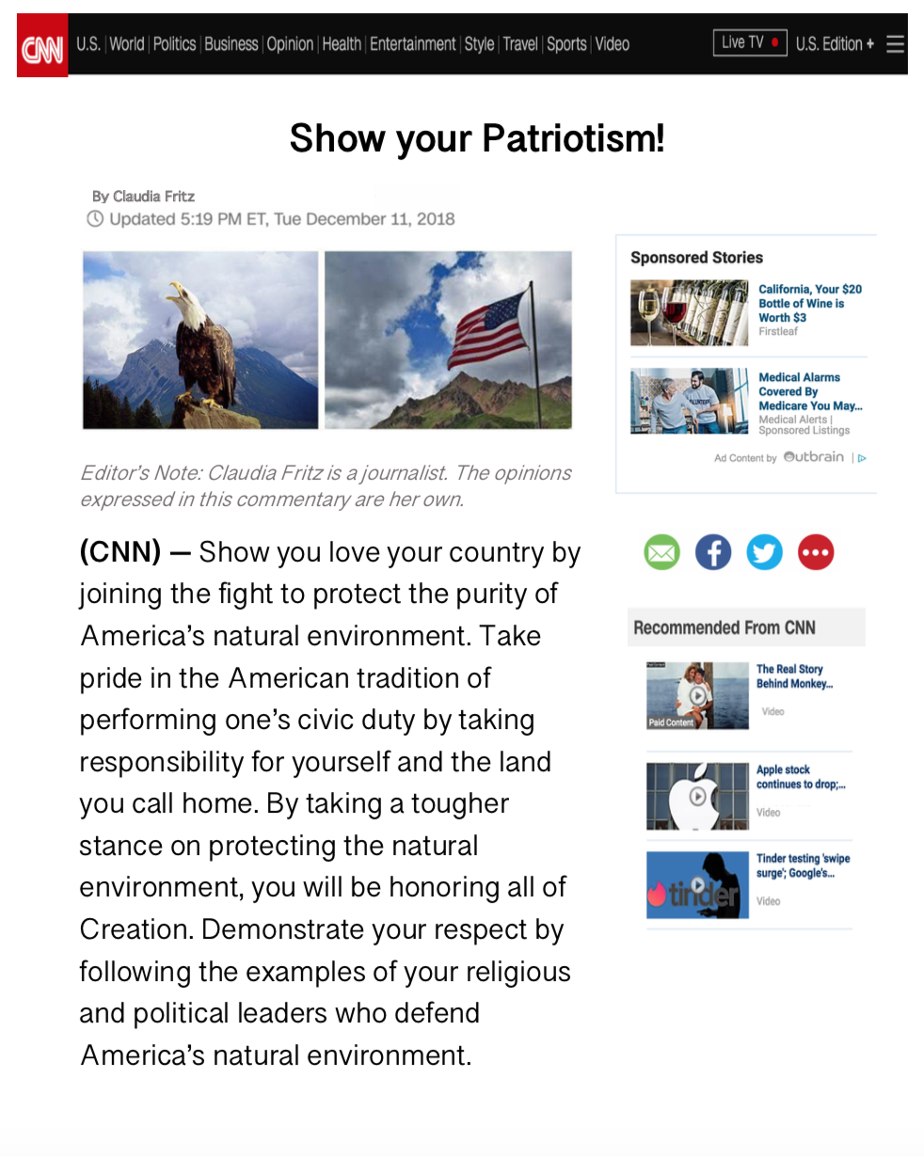
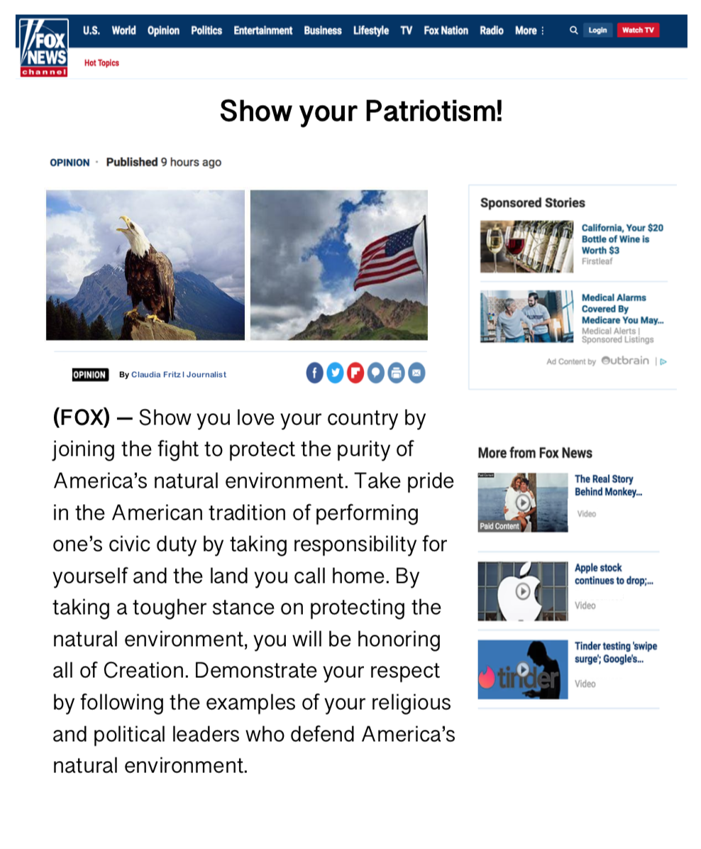
Experimental Design
Political Orientation of Logo
Liberal
Conservative
Individualizing
Moral Frame
Binding

Slide 28
Experimental Design
Political Orientation of Logo
Liberal
Conservative
Individualizing
Moral Frame
Binding
Notes:
Idea 3; Use Political Ideology as a covariate

Slide 29
Experimental Design
Political Orientation of Logo
Liberal
Conservative
Individualizing
Moral Frame
Binding
Notes:
Idea 3; Use Political Ideology as a covariate

Slide 30
Experimental Design
Political Orientation of Logo
Liberal
Conservative
Individualizing
Moral Frame
Binding
Notes:
Idea 3; Use Political Ideology as a covariate

Slide 31
Experimental Design
Political Orientation of Logo
Liberal
Conservative
Participants
Participants
Liberal
Conservative
Liberal
Conservative
Individualizing
Moral Frame
Participants
Participants
Liberal
Conservative
Liberal
Conservative
Binding
Notes:
Idea 3; Use Political Ideology as a covariate

Slide 32
Politically Congruent
High
Source
Credibility
Moral
Frame
Logo
Politically Incongruent
Low
Notes:
When the logo and the moral frame are politically congruent with the ideology of the participant, the source will be perceived to have high credibility, than when the logo and moral frame are politically incongruent

Slide 33
High
Positive Change
Source
Credibility
Attitude Change
Low
Pos. or Neg. Change
IND
FOX
Liberals
BND
Negative Attitude Change
Notes:
When perceived source credibility is high, we expect greater, more positive attitude change toward the environment, BUT WE DO NOT KNOW how low source credibility will influence attitude change.
For liberals, when both the logo and the moral frame are politically incongruent, it could produce negative attitude change. And when just the logo is political incongruent but not the moral frame, it could also produce negative attitude change or no change at all.
For conservatives, when both the logo and the moral frame are politically incongruent, it would produce negative attitude change. And when just the logo is political incongruent but not the moral frame, it could also produce negative attitude change or no change at all.
If there is a negative attitude change, then we would know that the source credibility is more powerful than the moral frame.
But if it’s the case that there is a positive attitude change, then we would know that the moral frame is more powerful than source credibility.
This is the first study in cognitive-political psychology, bc no one has viewed political attitude change as a function of moral foundations AND perceived source credibility.

Slide 34
High
Positive Change
Source
Credibility
Attitude Change
Low
Pos. or Neg. Change
IND
FOX
Liberals
BND
Negative Attitude Change
Notes:
When perceived source credibility is high, we expect greater, more positive attitude change toward the environment, BUT WE DO NOT KNOW how low source credibility will influence attitude change.
For liberals, when both the logo and the moral frame are politically incongruent, it could produce negative attitude change. And when just the logo is political incongruent but not the moral frame, it could also produce negative attitude change or no change at all.
For conservatives, when both the logo and the moral frame are politically incongruent, it would produce negative attitude change. And when just the logo is political incongruent but not the moral frame, it could also produce negative attitude change or no change at all.
If there is a negative attitude change, then we would know that the source credibility is more powerful than the moral frame.
But if it’s the case that there is a positive attitude change, then we would know that the moral frame is more powerful than source credibility.
This is the first study in cognitive-political psychology, bc no one has viewed political attitude change as a function of moral foundations AND perceived source credibility.

Slide 35
High
Positive Change
Source
Credibility
Attitude Change
Low
Pos. or Neg. Change
IND
FOX
Liberals
BND
Negative Attitude Change
IND
CNN
Conservatives
BND
Notes:
When perceived source credibility is high, we expect greater, more positive attitude change toward the environment, BUT WE DO NOT KNOW how low source credibility will influence attitude change.
For liberals, when both the logo and the moral frame are politically incongruent, it could produce negative attitude change. And when just the logo is political incongruent but not the moral frame, it could also produce negative attitude change or no change at all.
For conservatives, when both the logo and the moral frame are politically incongruent, it would produce negative attitude change. And when just the logo is political incongruent but not the moral frame, it could also produce negative attitude change or no change at all.
If there is a negative attitude change, then we would know that the source credibility is more powerful than the moral frame.
But if it’s the case that there is a positive attitude change, then we would know that the moral frame is more powerful than source credibility.
This is the first study in cognitive-political psychology, bc no one has viewed political attitude change as a function of moral foundations AND perceived source credibility.

Slide 36
High
Positive Change
Source
Credibility
Attitude Change
Low
Pos. or Neg. Change
IND
FOX
Liberals
BND
Negative Attitude Change
IND
CNN
Conservatives
BND
Notes:
When perceived source credibility is high, we expect greater, more positive attitude change toward the environment, BUT WE DO NOT KNOW how low source credibility will influence attitude change.
For liberals, when both the logo and the moral frame are politically incongruent, it could produce negative attitude change. And when just the logo is political incongruent but not the moral frame, it could also produce negative attitude change or no change at all.
For conservatives, when both the logo and the moral frame are politically incongruent, it would produce negative attitude change. And when just the logo is political incongruent but not the moral frame, it could also produce negative attitude change or no change at all.
If there is a negative attitude change, then we would know that the source credibility is more powerful than the moral frame.
But if it’s the case that there is a positive attitude change, then we would know that the moral frame is more powerful than source credibility.
This is the first study in cognitive-political psychology, bc no one has viewed political attitude change as a function of moral foundations AND perceived source credibility.

Slide 37
Negative Attitude Change
Source Credibility
Moral Frame

Slide 38
Moral Frame
Source Credibility
Positive Attitude Change

Slide 40
Hypotheses
Individualizing message embedded in CNN context will produce greater attitude change for liberals than for conservatives.
Individualizing message embedded in FOX context will produce greater attitude change for conservatives than for liberals.
Binding message embedded in CNN will produce greater, positive attitude change for liberals than for conservatives.
Binding message embedded in FOX will produce greater, positive attitude change for conservatives than for liberals.
High perceived source credibility will produce greater attitude change, when logo and moral frame are politically congruent with participants’ political ideology

Slide 41
References
Albarracin, D., & Shavitt, S. (2018). Attitudes and attitude change. Annual Review of Psychology, 69, 299-327.
Childers, T. L., & Jass, J. (2002). All dressed up with something to say: Effects of typeface semantic associations on brand perceptions and consumer memory. Journal of Consumer Psychology, 12(2), 93-106.
Clifford, S., & Jerit, J. (2013). How words do the work of politics: Moral foundations theory and the debate over stem cell research. The Journal of Politics, 75(3), 659-671.
Graham, J., Haidt, J., & Nosek, B. A. (2009). Liberals and conservatives rely on different sets of moral foundations. Journal of Personality and Social Psychology, 96(5), 1029.
Feinberg, M., & Willer, R. (2012). The moral roots of environmental attitudes. Psychological science, 24(1), 56-62.
Feinberg, M., & Willer, R. (2015). From gulf to bridge: when do moral arguments facilitate political influence?. Personality and Social Psychology Bulletin, 41(12), 1665-1681.
Ho, A. K., Sidanius, J., Kteily, N., Sheehy-Skeffington, J., Pratto, F., Henkel, K. E., ... & Stewart, A. L. (2015). The nature of social dominance orientation: Theorizing and measuring preferences for intergroup inequality using the new SDO7 scale. Journal of Personality and Social Psychology, 109(6), 1003.
Milfont, T. L., & Duckitt, J. (2010). The environmental attitudes inventory: A valid and reliable measure to assess the structure of environmental attitudes. Journal of Environmental Psychology, 30(1), 80-94.
Ohanian, R. (1990). Construction and validation of a scale to measure celebrity endorsers' perceived expertise, trustworthiness, and attractiveness. Journal of advertising, 19(3), 39-52.
Petty, R. E., & Cacioppo, J. T. (1986). The elaboration likelihood model of persuasion. In Communication and Persuasion (pp. 1-24). Springer, New York, NY.
Wolsko, C., Ariceaga, H., & Seiden, J. (2016). Red, white, and blue enough to be green: Effects of moral framing on climate change attitudes and conservation behaviors. Journal of Experimental Social Psychology, 65, 7-19.

